Slide 1
Predicted Salaries for Various Job Roles
Alyshia Kiczma, Nasir Qadri, Kaylyn Valdez-Scott, Arshdeep Khurana

Slide 2
Introduction
Purpose
Data Set
Data Cleaning
Visualizations
Machine Learning Model
Conclusion

Slide 3
Purpose
To analyze survey data to make conclusions on various factors primarily based on salaries for various jobs.
Additionally, looking at various factors such as location, education, job titles, gender, and company to analyze salary behaviors.

Slide 4
Data Set
Survey data of approximately 60,000+ individuals providing insight into factors such as between the years of 2017 to 2021:
Gender
Base Salary
Bonus
Race
Location
Total Yearly Compensation
Education Level
Stock Grants and their Value
Number of years at the Company
Total years of Experience
Title
Role Level
Note: Not all entrants of the survey provided response to all the above columns

Slide 5
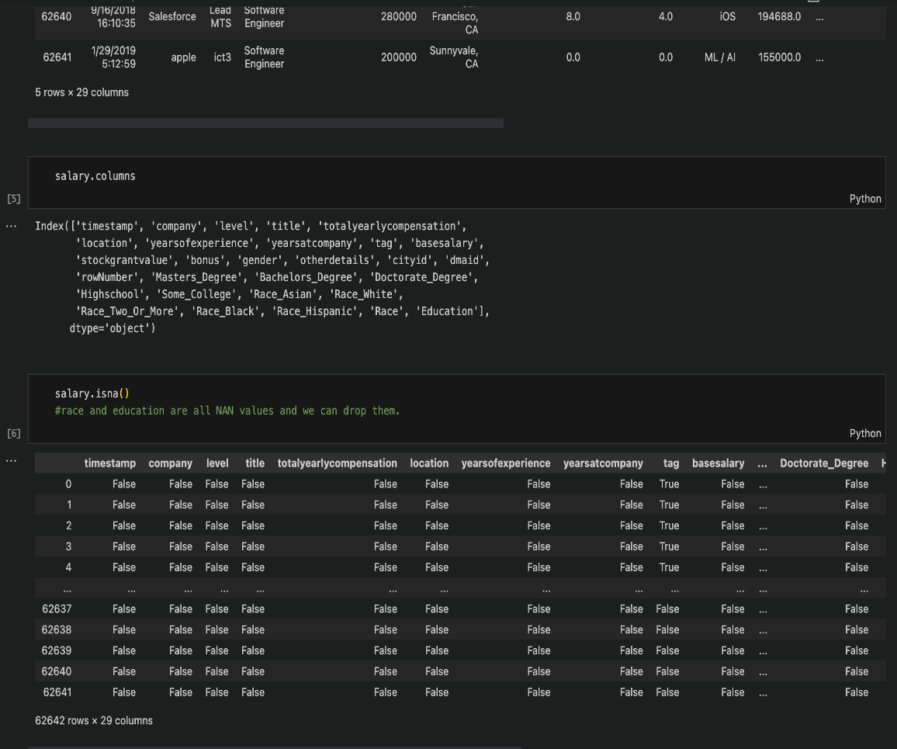
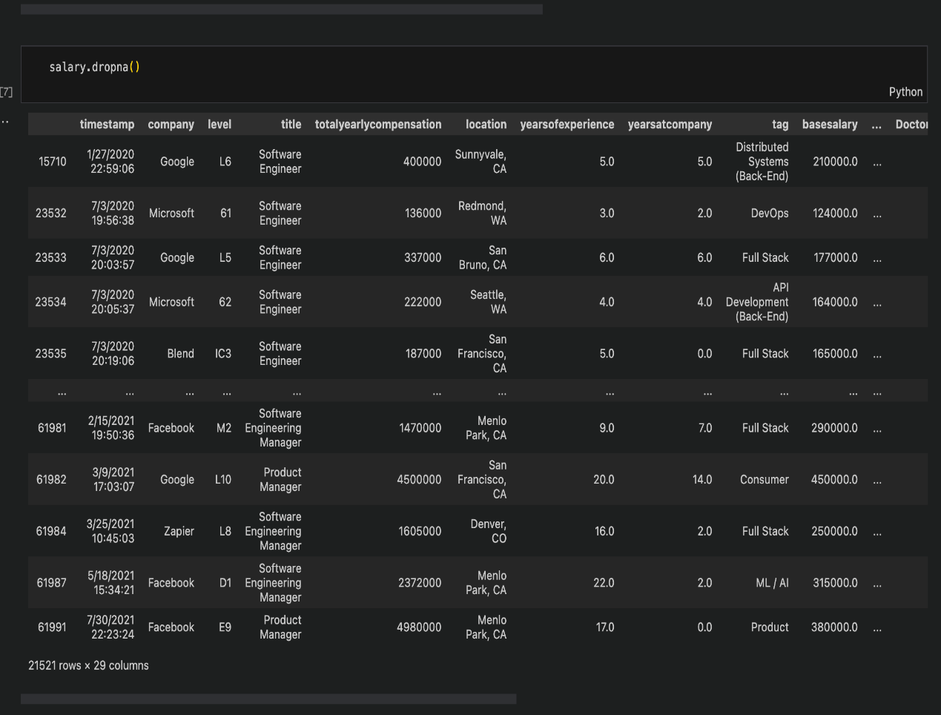
Data Cleaning

Slide 6
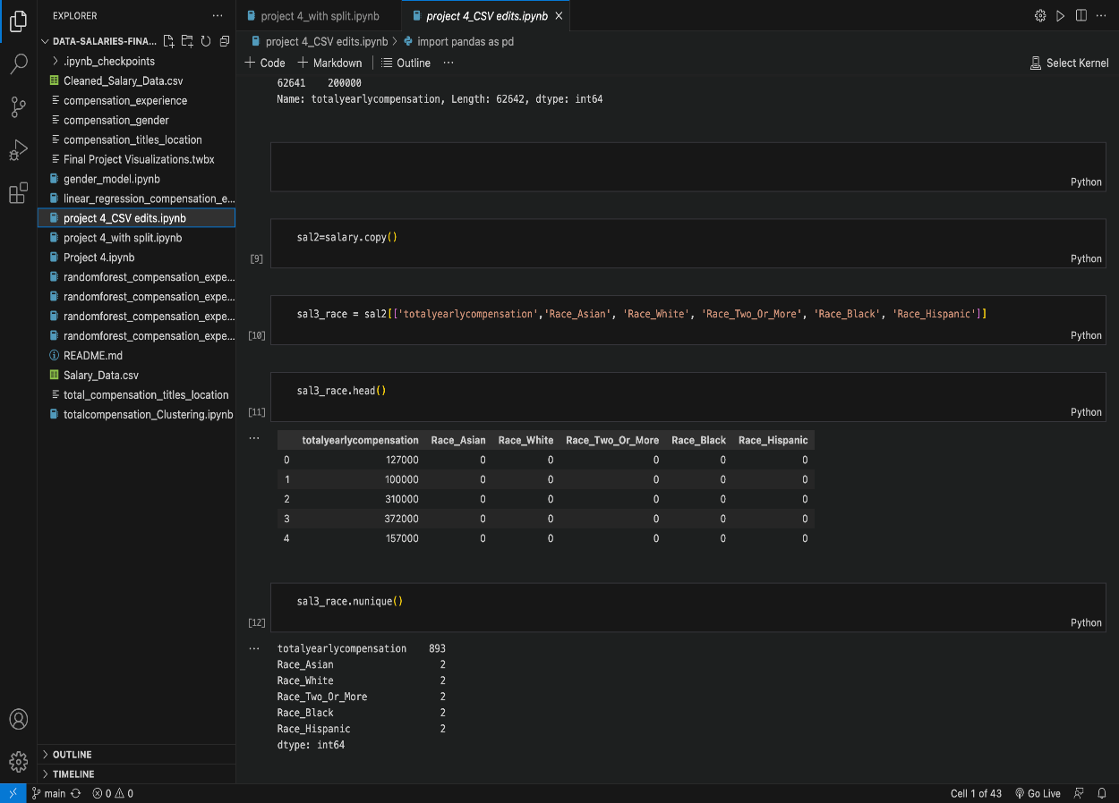
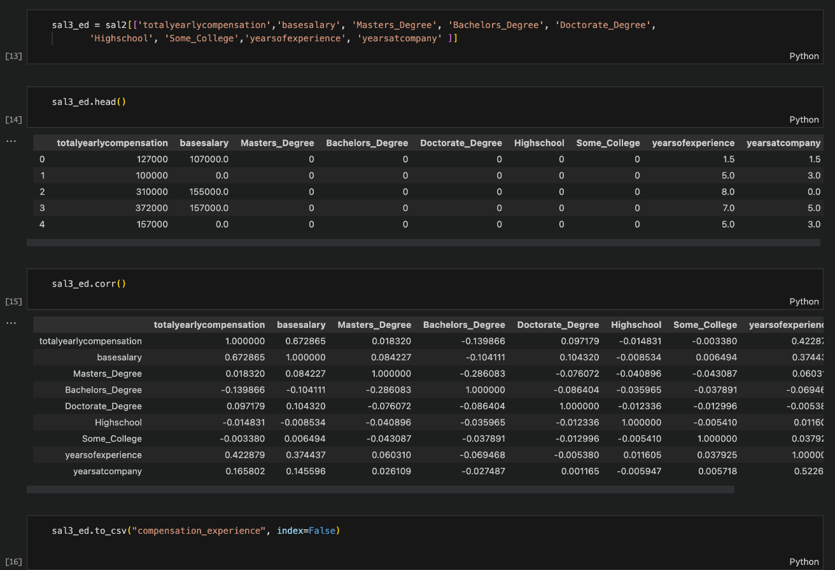
Data Cleaning

Slide 7
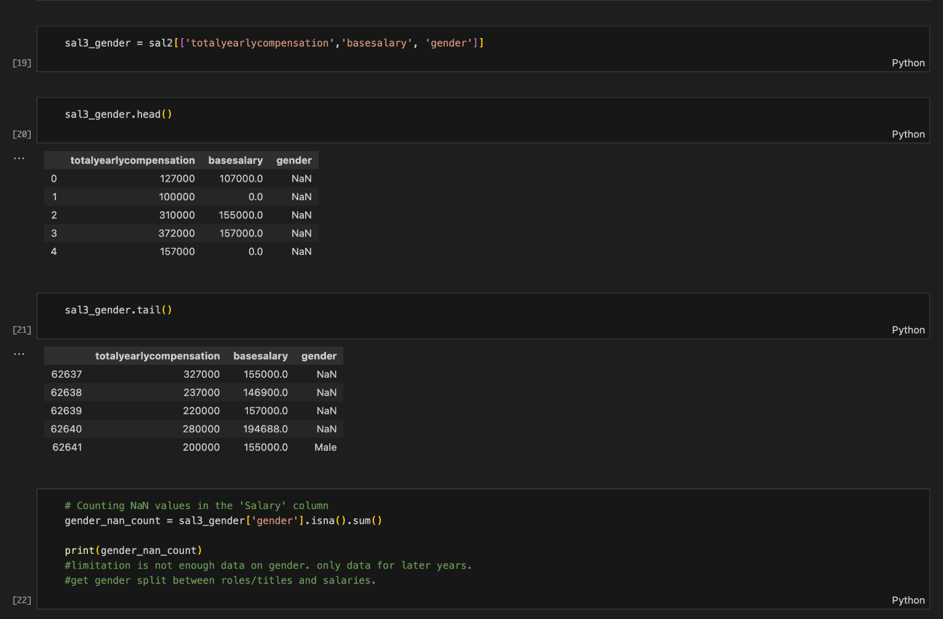
Data Cleaning

Slide 8
VISUALIZATIONS

Slide 9
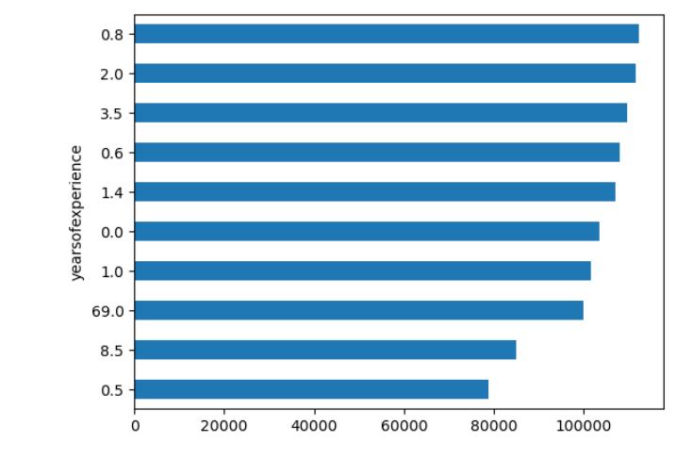
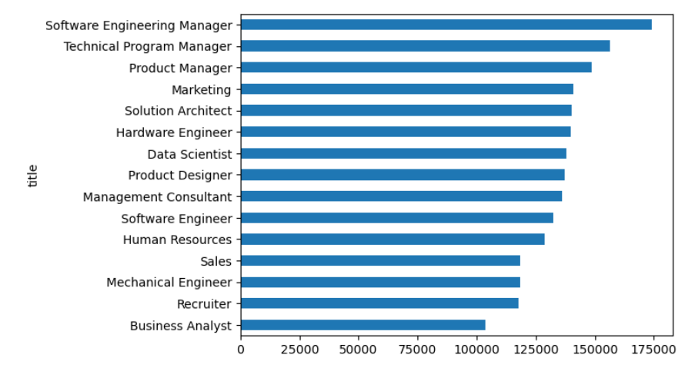

Slide 10
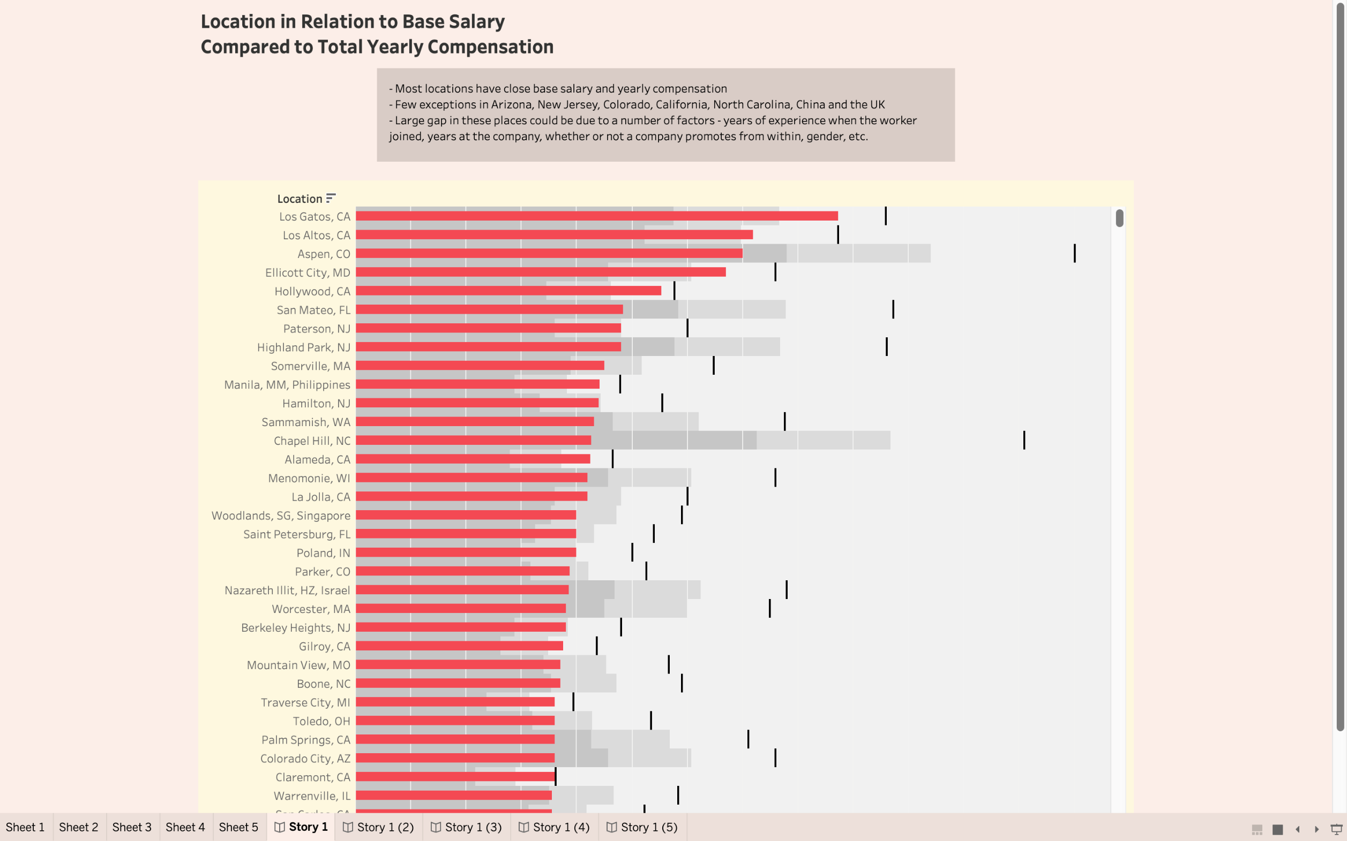

Slide 11
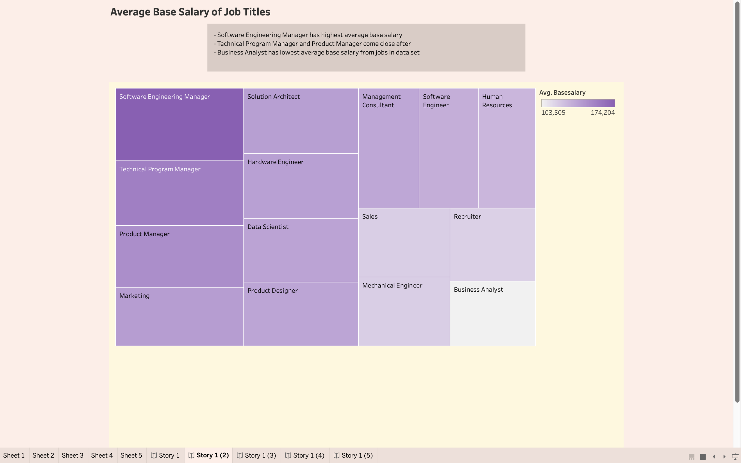

Slide 12
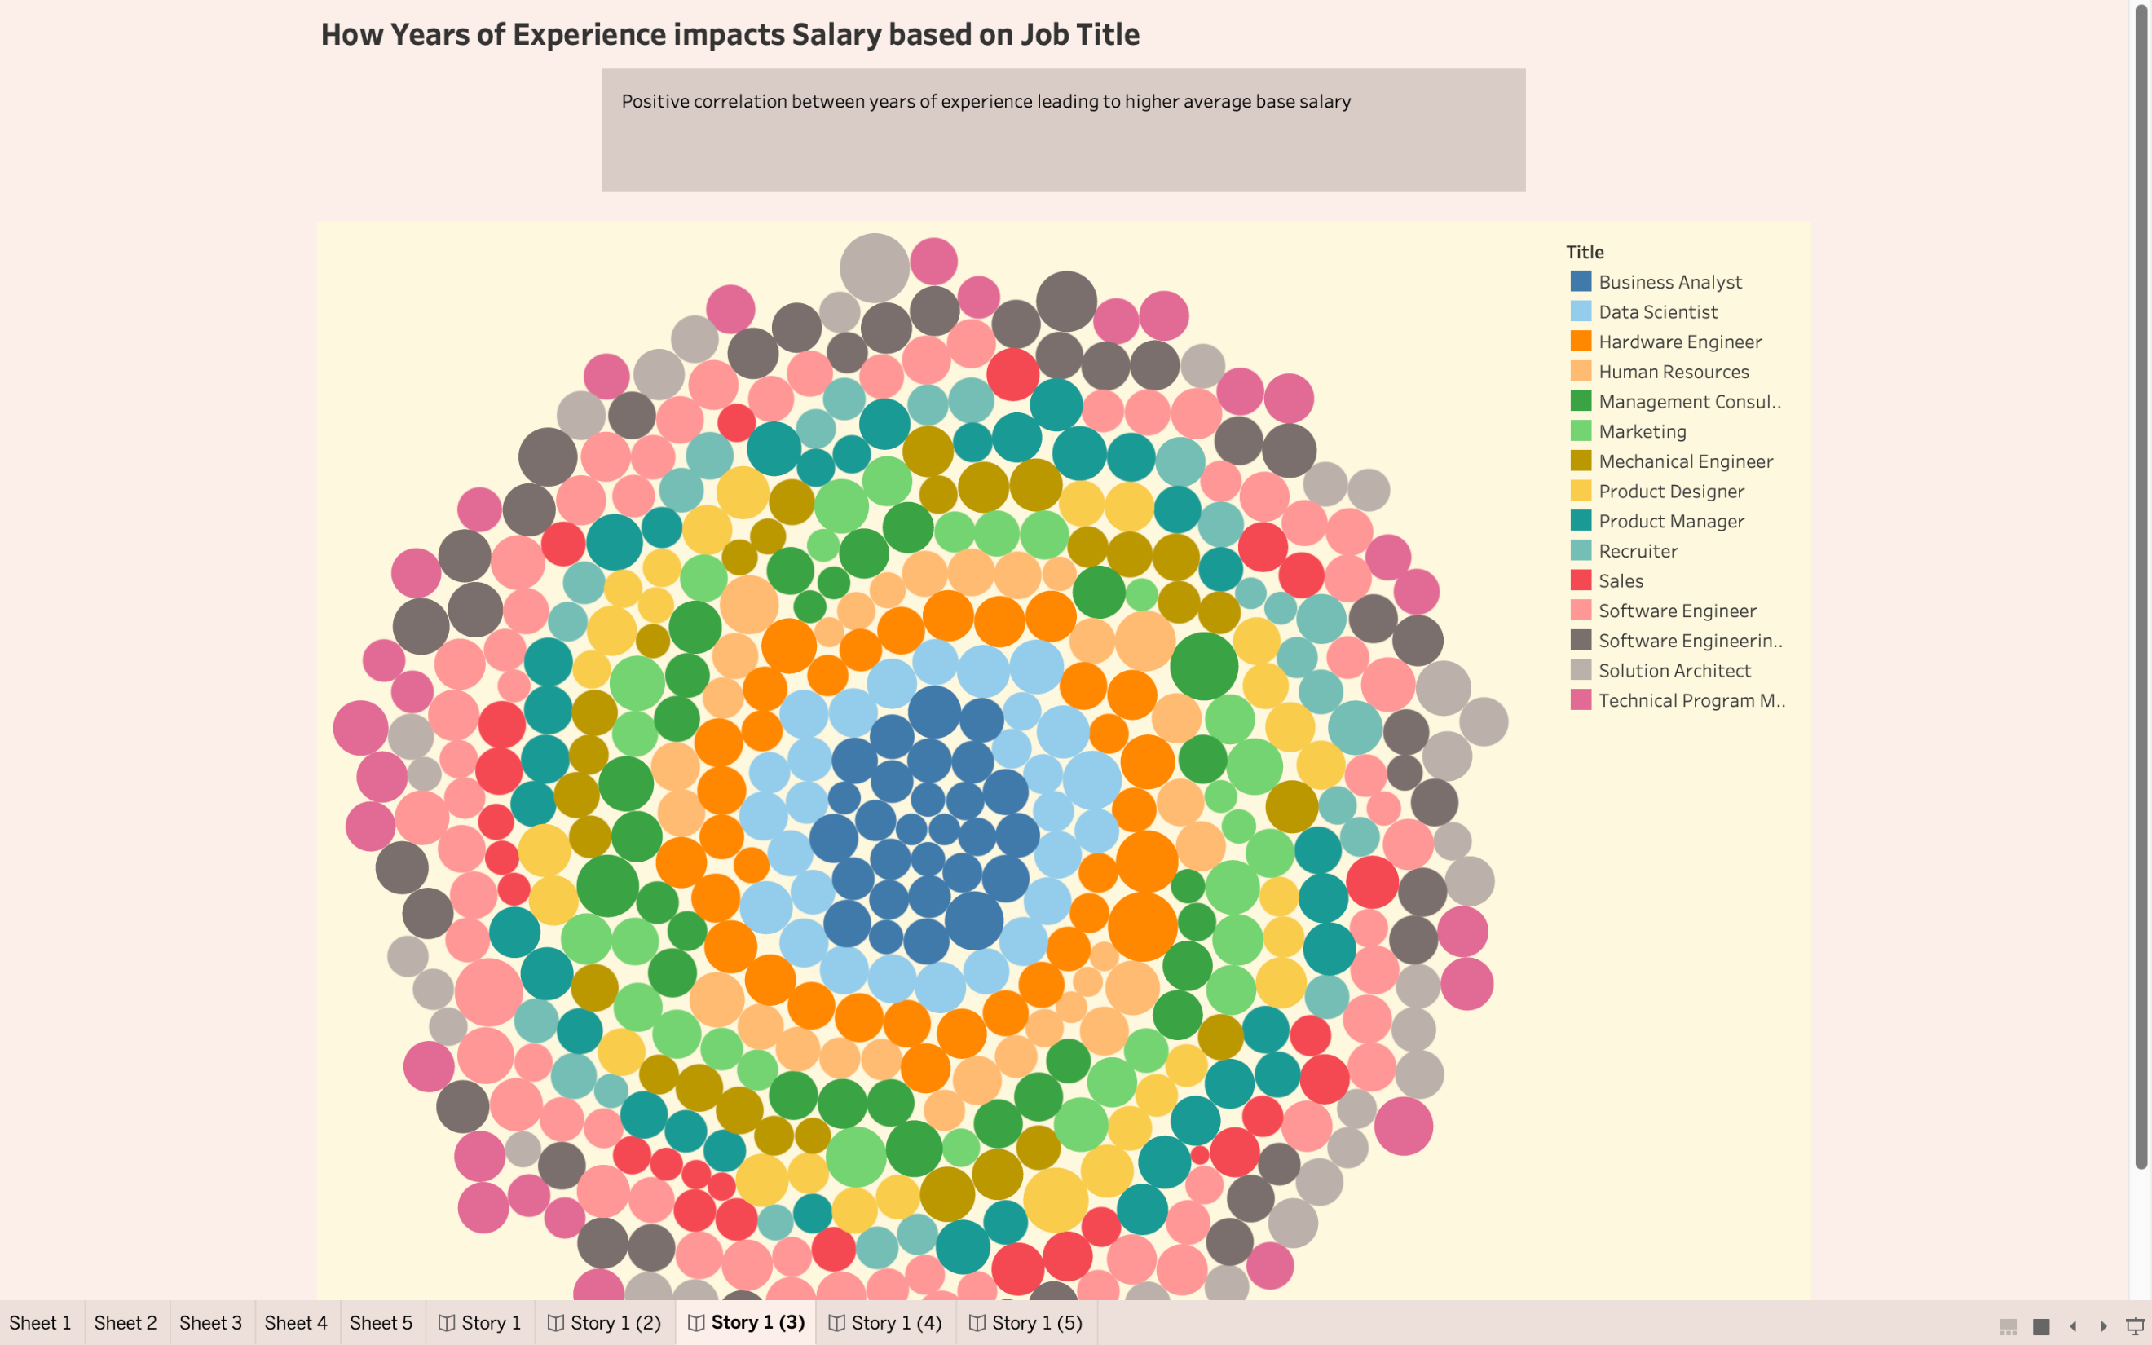

Slide 13
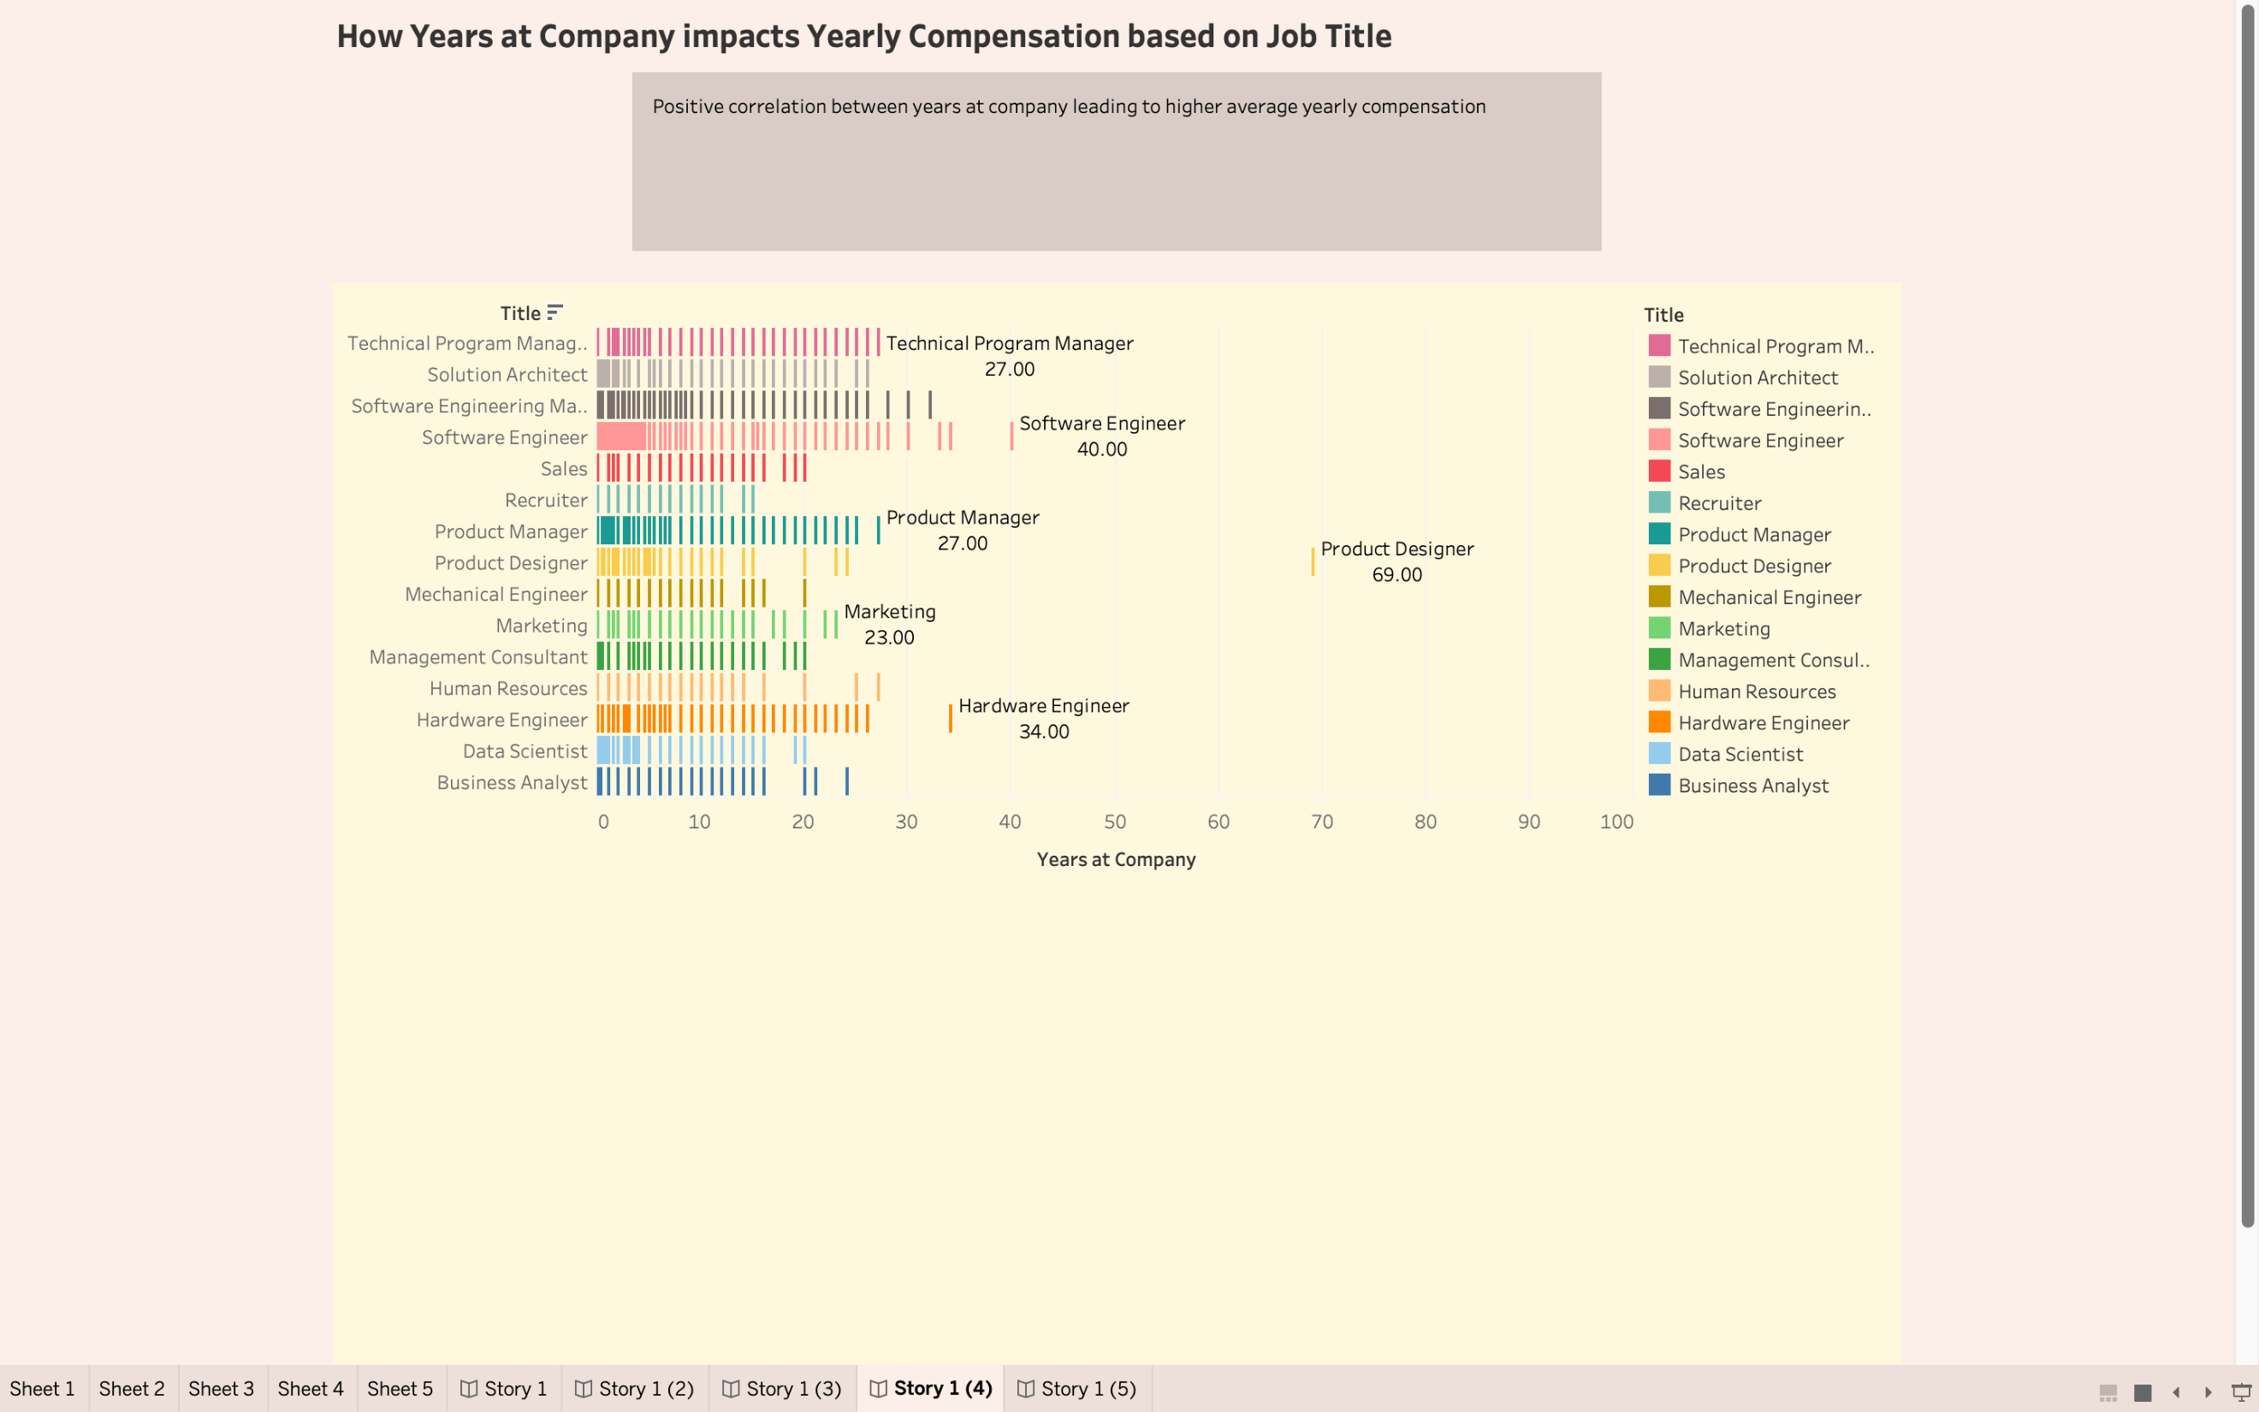

Slide 14
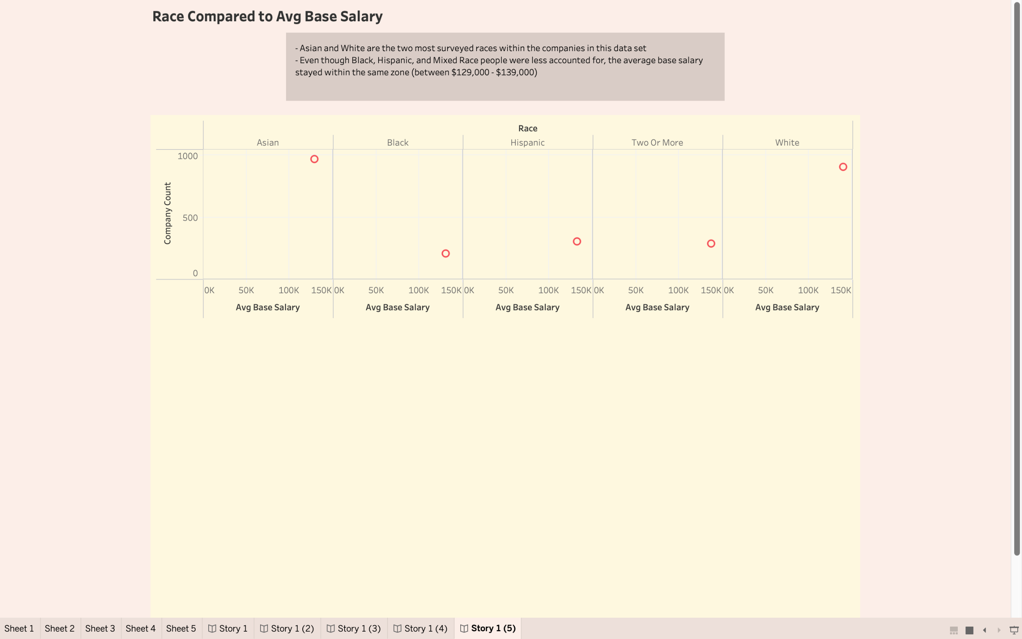

Slide 15
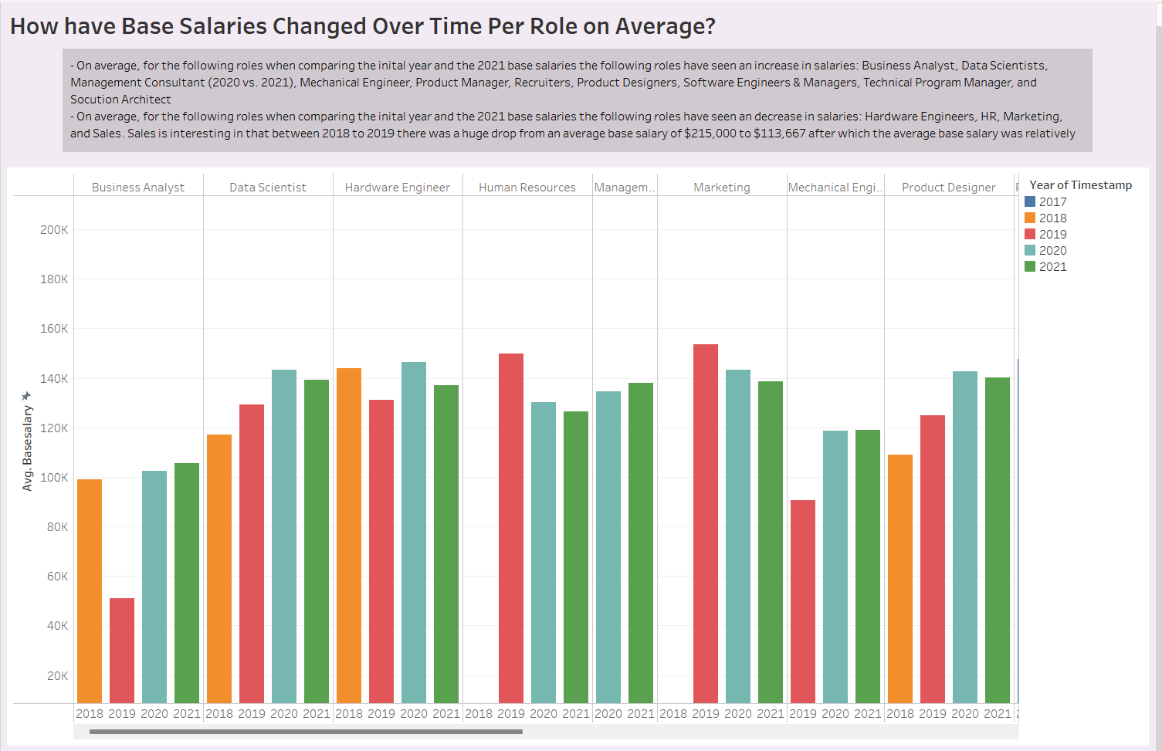
Visualizations

Slide 16
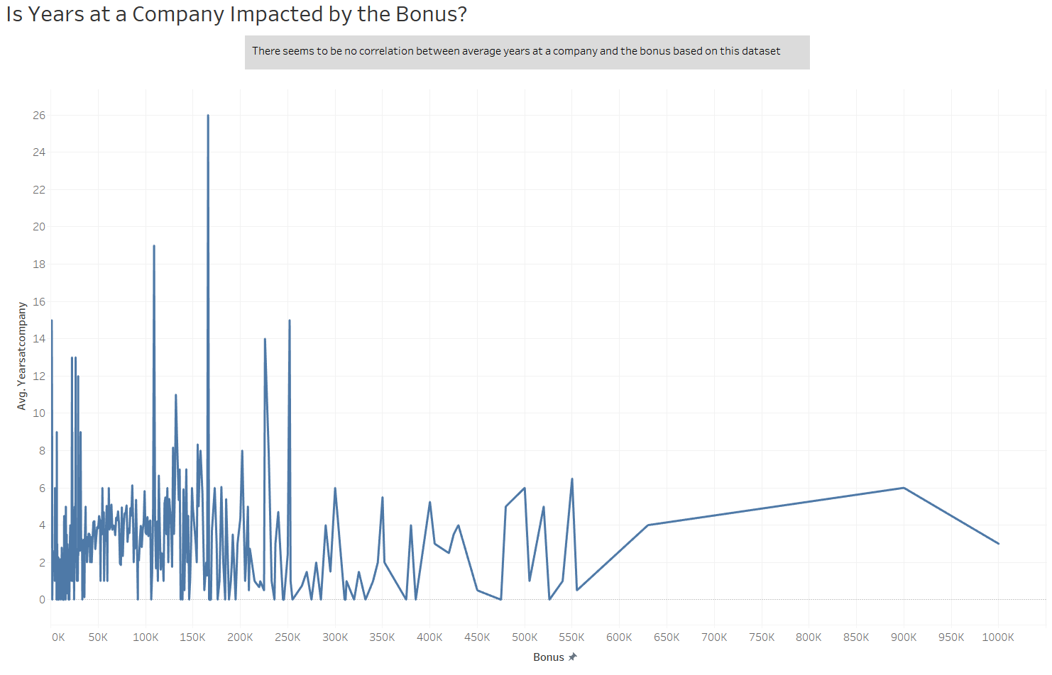
Visualizations

Slide 17
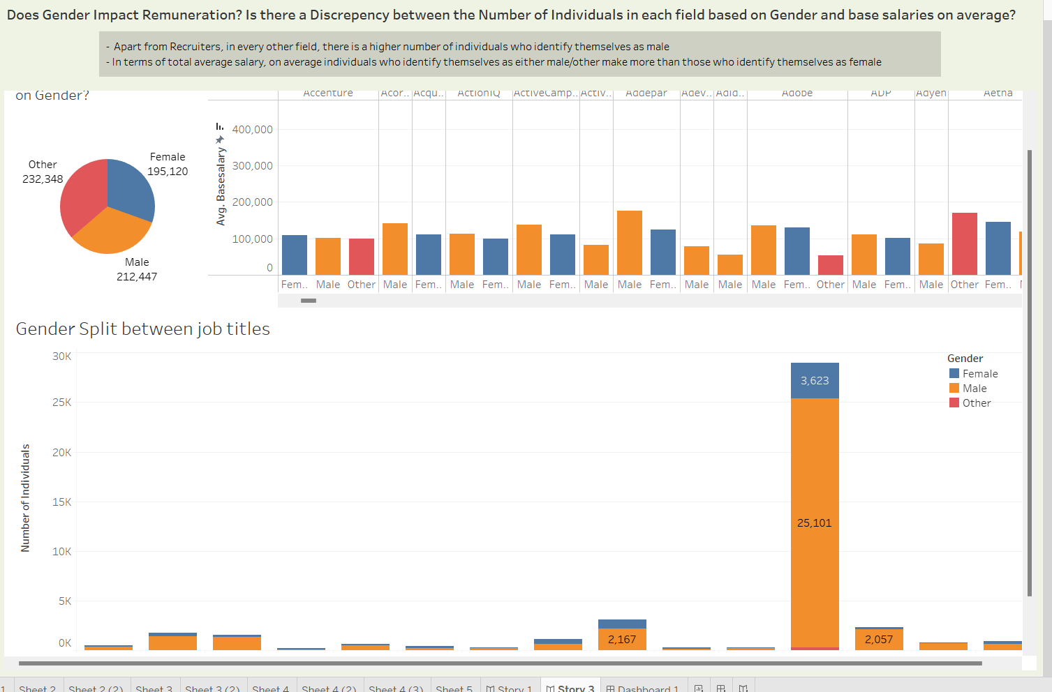
Visualizations

Slide 18
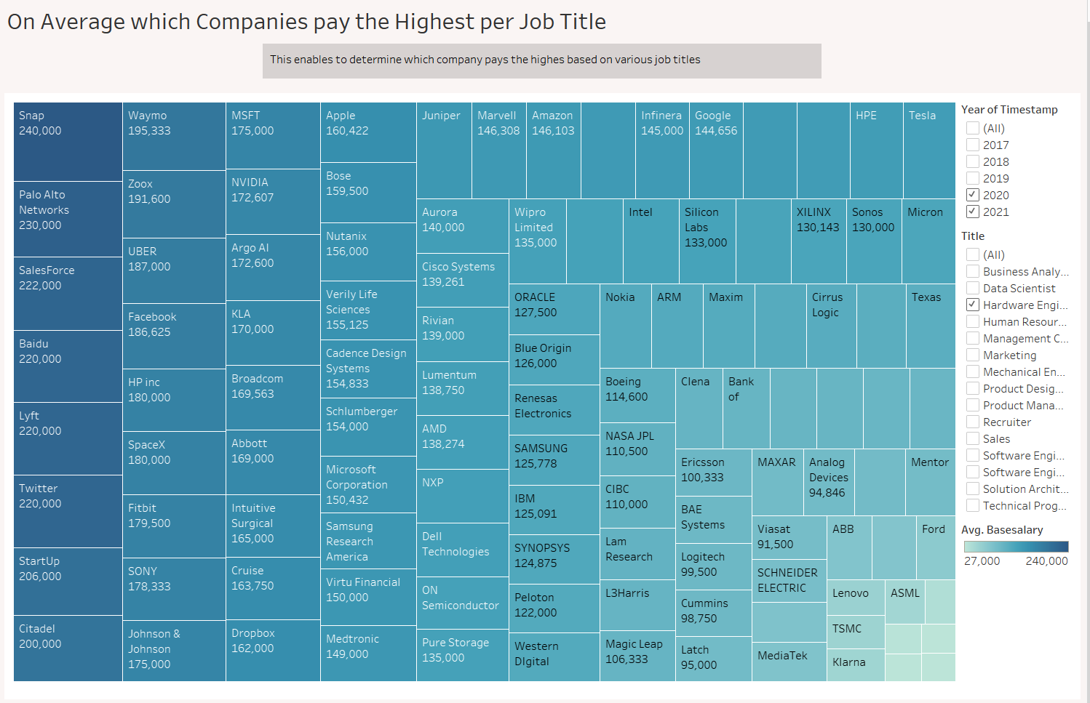
Visualizations

Slide 19
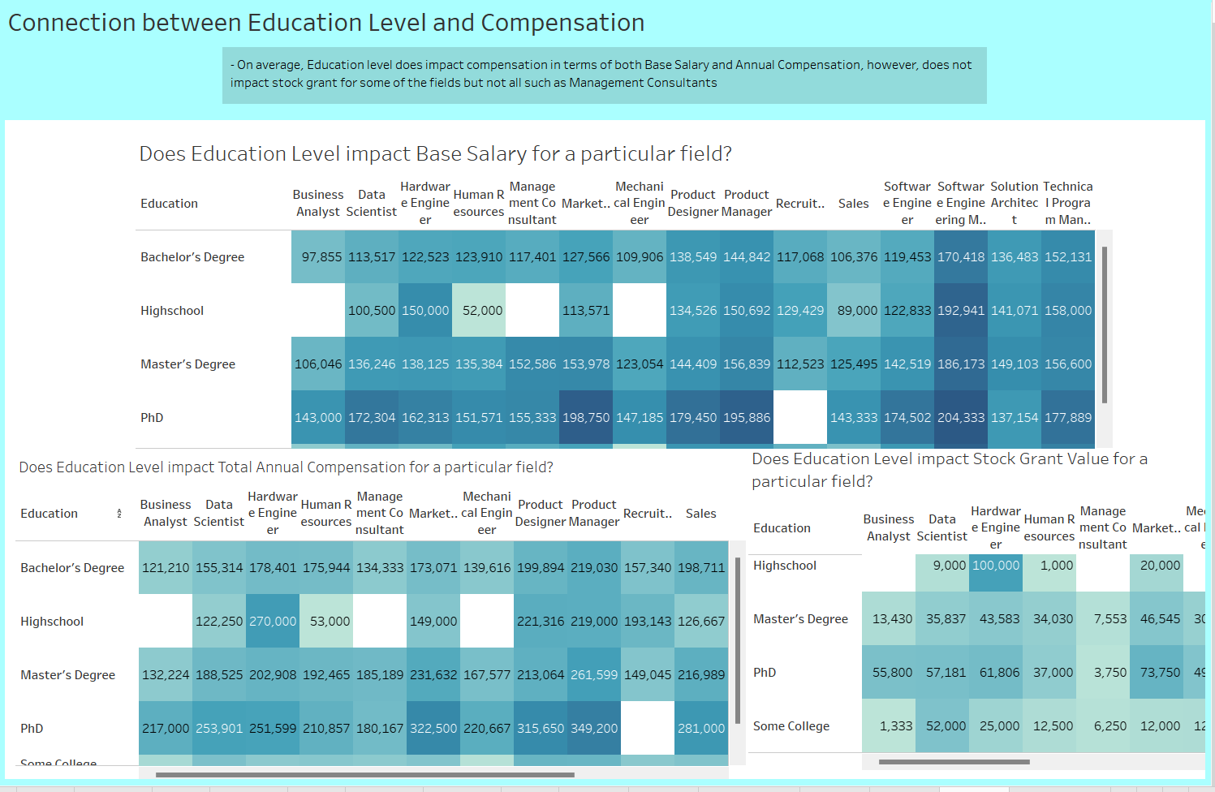
Visualizations

Slide 20
MACHINE LEARNING

Slide 21
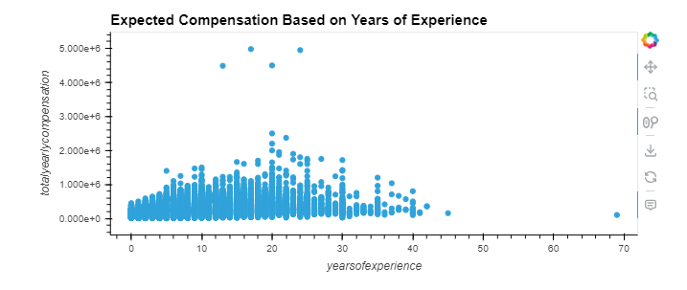
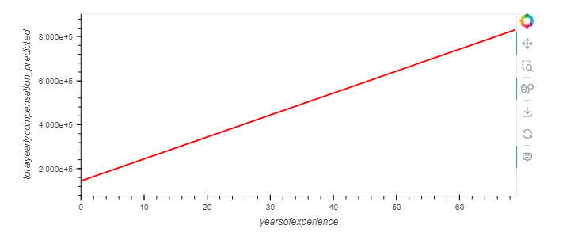
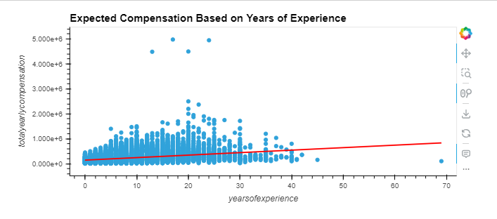
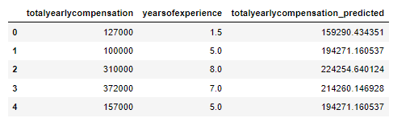
Linear Regression
Expected Compensation based on years of experience
Used the model to predict
r squared 0.18
not a simple relationship

Slide 22
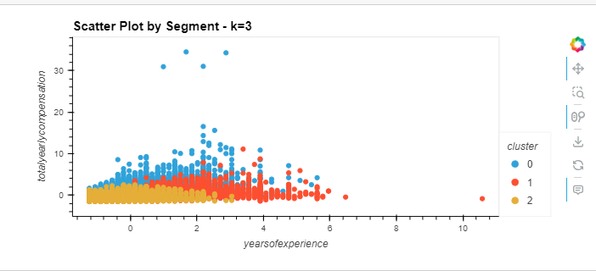
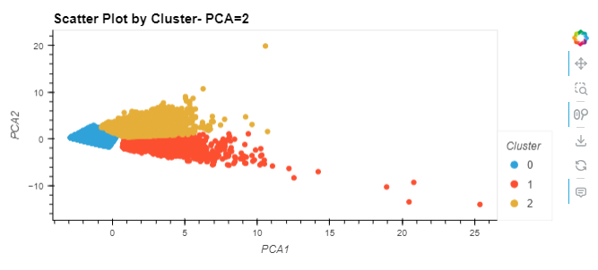
Machine Learning Model - Clustering
Clustering by segments
using scikitlearn
years of experience vs total compensation
k-means analysis to determine that 3 clusters fit the data
PCA analysis to do more clustering analysis

Slide 23
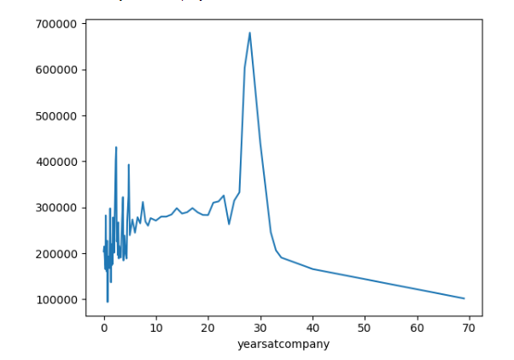
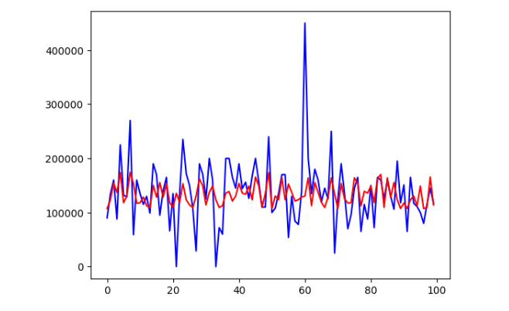
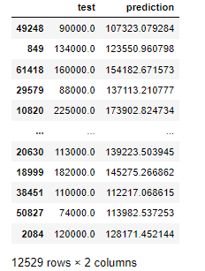
Machine Learning Random Forest
predicting salary based on years of experience at a company
model using LightGBM
red = test
blue = predictions

Slide 24
Conclusion
Correlations were found between various factors that we investigated such as years spent at company and years of experience to average base salary to name a few.
The visualizations explained in more detail provided greater insight into the relationships that were investigated.

Slide 25
THANK YOU!

